Slide 1
UAP Repeat Exam Registration System
Md Mehedi Hasan, ID : 16201073
Md All Mamun, ID : 16201071
Arafat Bi Kashem, ID: 16201066

Slide 2
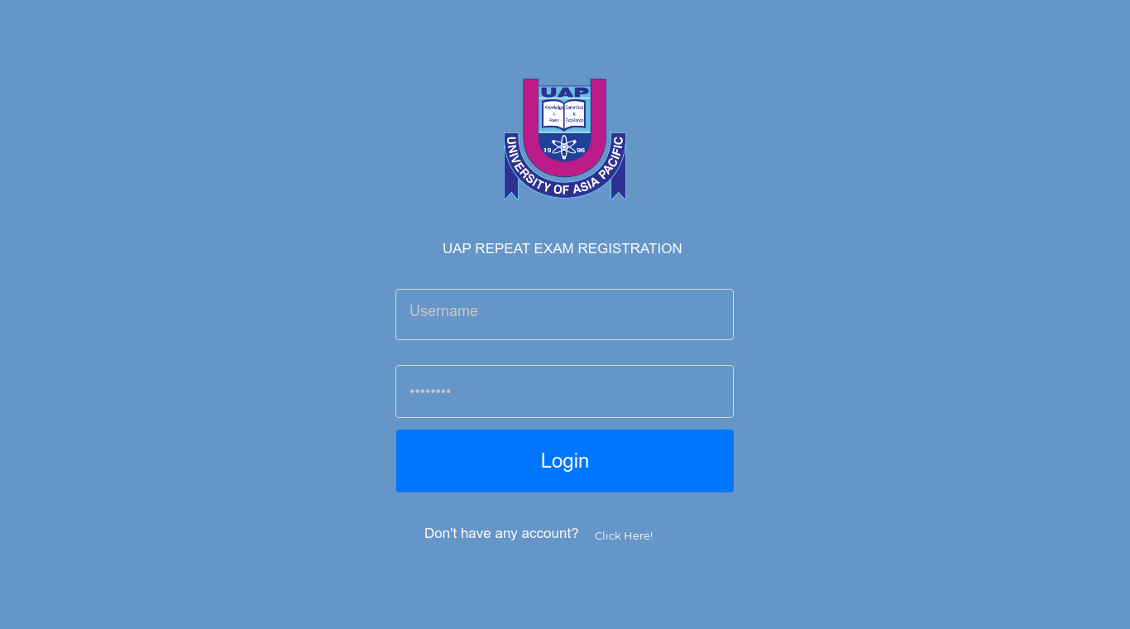
Home page

Slide 3
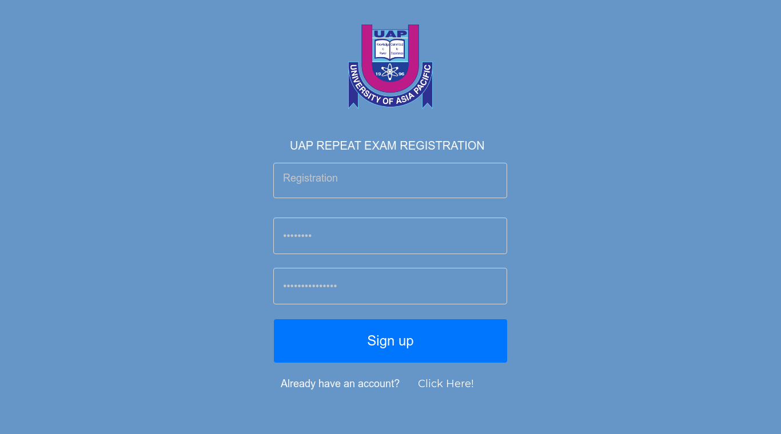
Sign up

Slide 4
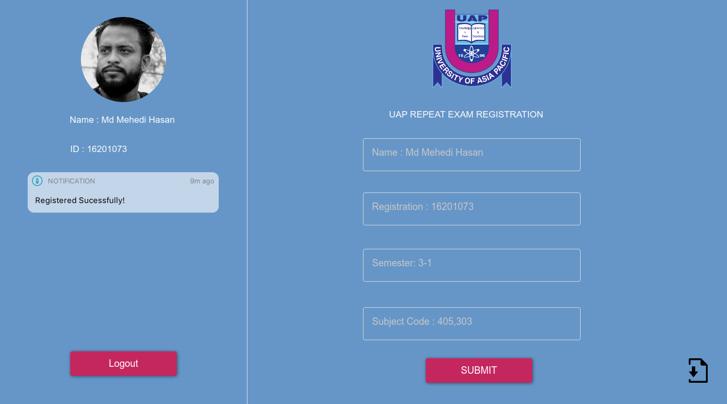
Registration Page

Slide 5
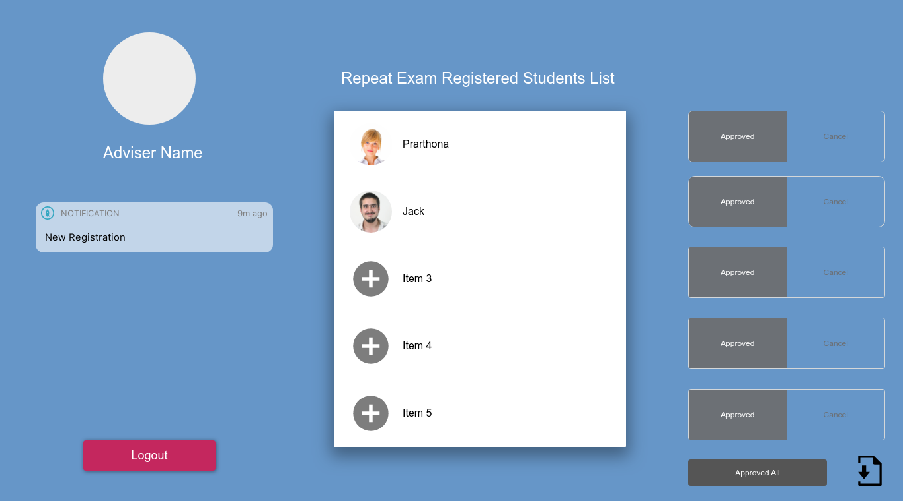
Adviser Page

Slide 6
Thank You!

